Slide 1

School members meeting
August 2016
This PowerPoint presentation can be downloaded from the SSTA website at
www.ssta.org.uk/ppaug2016

Slide 2
Welcome back!

Slide 3
SSTA Indicative ballot, April/May 2016
96% believe the measures proposed in the ‘Tackling Bureaucracy follow-up report’ have not delivered a reduction in teacher workload
Nearly 96% are not confident that the measures proposed by the SQA will deliver reductions in teacher workload in session 2016-17
Over 93% are not confident that measures proposed by the SQA will reduce workload in the long term
Notes:
Links:
Tackling Bureaucracy follow-up report: http://www.gov.scot/Resource/0047/00473538.pdf
Working Group on Assessment and National Qualifications WG report: http://www.gov.scot/Topics/Education/Schools/WorkingGrouponAssessmentandNQs/ANQGroupPaper

Slide 4
SSTA Indicative ballot
Nearly 64% are prepared to take ‘strike action’ to reduce teacher workload
Over 91% are prepared to take ‘action short of strike action’ to reduce teacher workload
Notes:
Indicative ballot details: https://ssta.org.uk/2016/06/ssta-prepared-take-action-cut-teacher-workload/
The EIS has reported over 95% support for industrial action short of strike action.

Slide 5
Questions to consider
What are the main factors giving rise to increases in workload?
Is workload likely to increase, decrease, or stay about the same in the short term?
To what extent is reducing workload a genuine priority?
What can realistically be achieved?
How can it be achieved? Who is listening?
Notes:
Chaired discussion, moving towards a clear sense of purpose.
The government has been dragging its heels on workload for a number of years.

Slide 6
Next steps
SSTA National Executive has authorised a formal ballot of members for ‘action short of strike action’
This ballot will take place in September
Unlike the informal ballot which was by email, the law requires a formal ballot to be postal
If you have changed postal address recently, make sure the SSTA office is aware. Your school rep can pass this on.
Notes:
Ballot papers must, by law, be sent to members’ home addresses. It is really important that the SSTA has current accurate records.

Slide 7
Voting
SSTA negotiators need your support, please remember to vote
A few moments spent voting could make a remarkable long-term difference to your workload
The results of the recent indicative ballot are beginning to have an effect, but more pressure is required
A high vote in the formal ballot will give negotiators powerful leverage in discussions
Notes:
A ballot such as this is a bit like a petition: the more support it has, the stronger its effect can be.
It’s really important that teaching unions are working together on this.

Slide 8
Voting
Postage and legal requirements mean that a formal ballot costs much more than an indicative ballot
Every vote costs more than £1 for each member
By making sure you vote you are helping to ensure that union resources are not wasted and the ballot is representative of your views.
Notes:
If large numbers choose not to vote, or forget to vote, or don’t get round to it, politicians and others will get the impression that teachers think workload is acceptable.

Slide 9
What is ‘action short of strike action’?
Coordinated with other unions
Does not affect pay
Defined actions which will not be carried out
Will involve matters which can still be completed in line with contractual obligations
Achieving what can be done within a 35 hour week.
Notes:
A previous ‘work to rule’ was not uniformly effective. If, following a vote, it becomes necessary to take action, it will need to be well-focused, well-defined, and in collaboration with other teaching unions.
There needs to be the possibility of action quickly to start making a difference soon.

Slide 10
Are you prepared to take ‘action short of strike action’?
Vote yes
Post your ballot paper on the day you receive it
Make a positive difference to your workload
Start claiming back your time
Improve education
Notes:
Don’t put off voting, don’t wait until you get round to it. Mark and post your ballot paper as soon as you receive it.

Slide 11
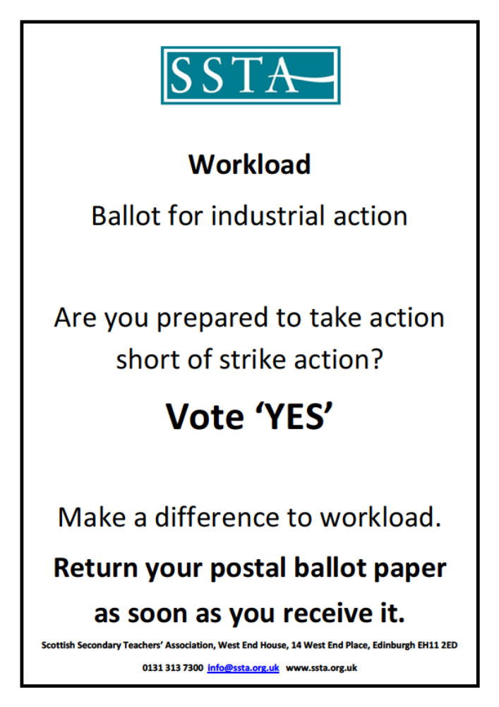
Notes:
Don’t put off voting, don’t wait until you get round to it. Mark and post your ballot paper as soon as you receive it.

