Slide 1


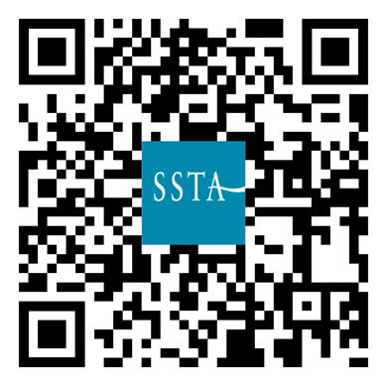
THE Secondary Teachers’ Union
NQTs pay nothing for 16 months
Others get 50% off for 12 months
Use your phone camera to join:
We believe it to be essential that secondary teachers’ views are strongly represented.
With over 6,000 members, the SSTA represents about a third of Scottish secondary teachers.
Every member has direct and immediate access to full-time union officials for support and advice.
www.ssta.org.uk/join

Slide 2
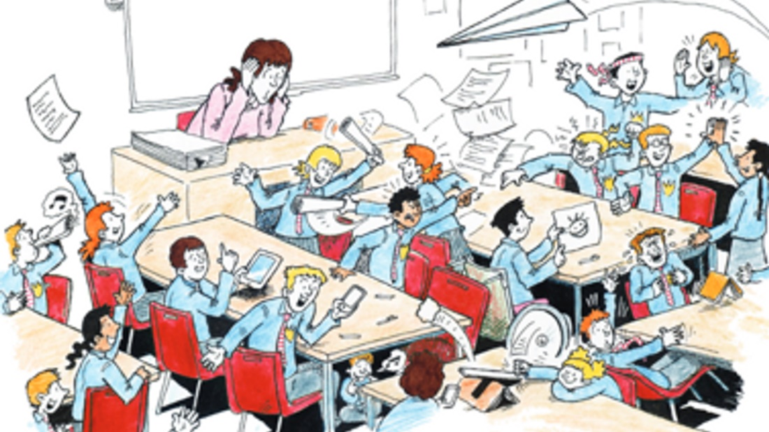
SSTA NQT’s
Classroom Management, SEN and Top Tips on Parent’s Evenings Webinar

Slide 3

Who are we?
Casey Enkel – Drama – Peterhead Academy
(Aberdeenshire)
Sarah Dargie – Biology –
St Benedict’s High School
(Renfrewshire)

Slide 4

What works well for us?
Notes:
Routines, rules, boundaries, contracts (rule of three)
Practical vs Theory
Stickers/bribes/rewards
Positivity & restorative conversations
KNOWING the kids in front of you, and letting them know you – relationships first

Slide 5


Slide 6

Before the lesson
Think about all the aspects you have control over before you teach the class
Think about all the aspects you have do not have control over before you teach the class

Slide 7

During the lesson
Plan for 45 minutes!
Chunk the lesson but not too much
Uphold discipline consistently but in a way you can maintain
Have something as a back up

Slide 8

After the lesson
Make sure you you make time to review
Only change one thing and try it a few times
If you get 70% of the class on board, you’re there!

Slide 9

That one class from a horror film…
Everyone has that ‘one’ class.
Even mix boys and girls
Topic
8 weeks
This is the one I will learn the most from!

Slide 10
What works well for you?
Notes:
Routines, rules, boundaries, contracts (rule of three)
Practical vs Theory
Stickers/bribes/rewards
Positivity & restorative conversations
KNOWING the kids in front of you, and letting them know you – relationships first

Slide 11

Good Reading:
Getting the Buggers to Behave – Sue Cowley
Effective Teaching in Schools – Theory and Practice – Chris Kyriacou
Engaging Learners – Mark Burns
The Teaching Delusion books 1-3 – Bruce Robertson
The Teachers Toolkit – Paul Ginnis
Take Control of the Noisy Class – Rob Plevin
When the Adult Changes, Everything Changes – Paul Dix

Slide 12

SEN – tips and tricks
Overview of last time – finding the information that you need
Do you teach to the top and differentiate down? Or to the middle?
Is there anything you have discovered which has transformed your practice?

Slide 13
Good Reading:
The Ultimate Guide to Differentiation – Sue Cowley
Teach like a Champion (3) Doug Lemov
Differentiation Pocket Book – Peter Anstee
How to Use Differentiation in the Classroom – Mike Gershon
Kagan Cooperative Learning – Dr Spencer Kagan, Miguel Kagan
Getting the Buggers to Learn – Duncan Grey
The Seven T’s of Practical Differentiation – Sue Cowley

Slide 14
Parents Evenings
Know who is actually sitting in front of you
Do you teach more than 1 subject? Have you checked which subject the parents are there for?
Don’t overcomplicate
Know what you’re going to say before you go in (have a script)
Are you taking in work examples?
Any Questions?

Slide 15

What happens if I need someone?
Remember your union is here for you!
school Reps
info@ssta.org.uk
0131 313 7300.
You also have your departments – never underestimate how much help your colleagues can be!

Slide 16

Any Questions/ Issues?

Slide 17
Scottish Secondary Teachers’ Association
If you have a query not answered by this information, please do not hesitate to contact the Association via email at info@ssta.org.uk or via telephone at 0131 313 7300.

